Slide 1
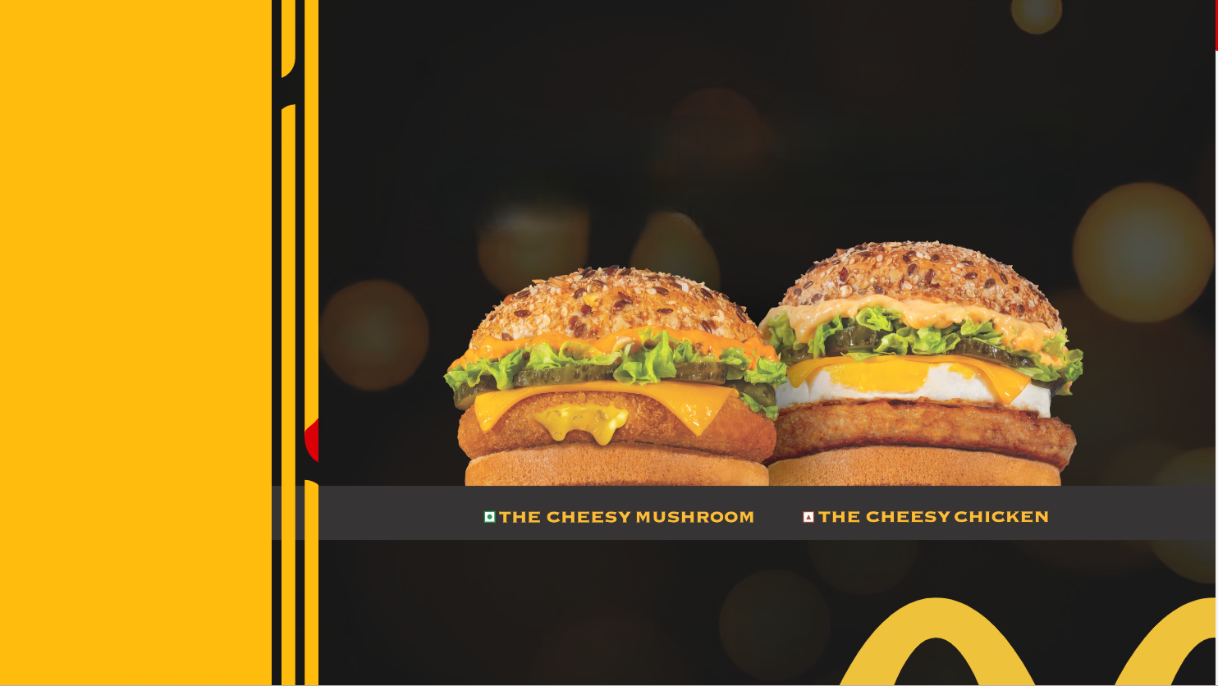
McDonal’s
Sales Performance Analysis
Presented by Tushar Dhamankar - Cohort 11

Slide 2
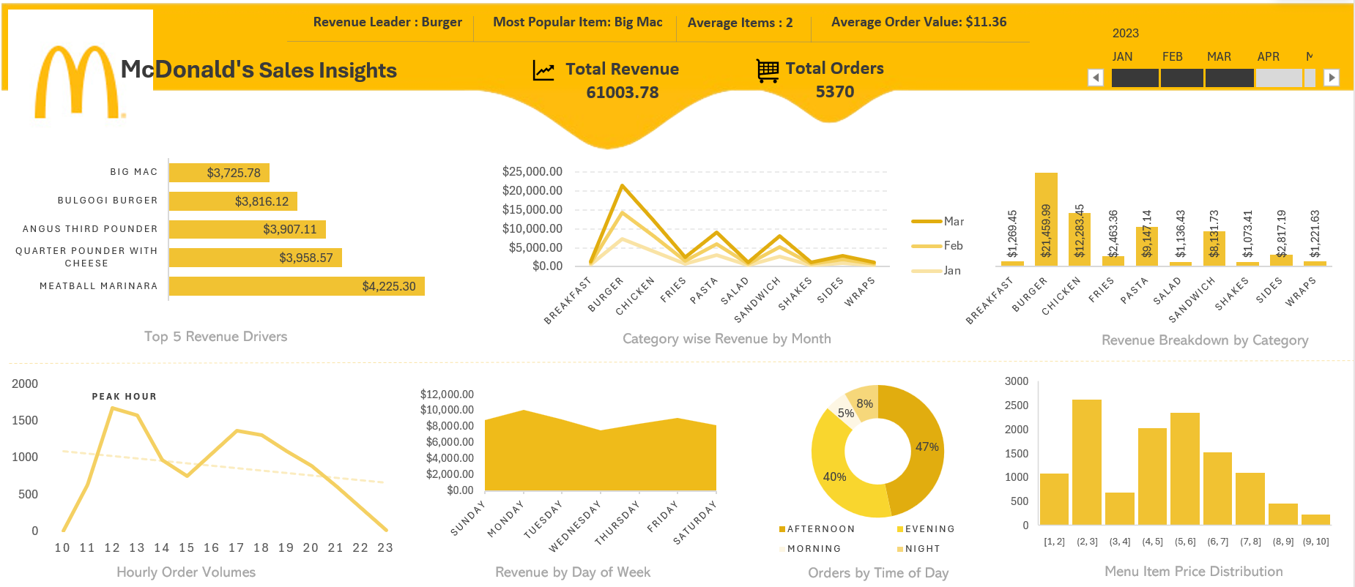
McDonald’s Sales Insights Dashboard

Slide 3



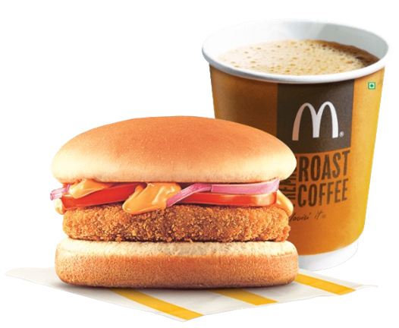
Overall Performance
Total Revenue: $61,003.78 | Total Orders: 5,370 | Average Order Value: $11.36
Insights
Each customer spends ~$11 per visit.
Revenue is stable across Jan–Mar (~$20K each month).
Business is consistent, not highly volatile.
During the January–March period, the business generated $61K in revenue from 5,370 orders, maintaining a steady monthly average of ~$20K. The consistent Average Order Value of $11.36 indicates stable customer spending behavior and predictable sales performance.

Slide 4
Revenue & Volume Leaders
Revenue Leader Burger Category
$21,459.99 (~35% of total revenue)
Volume Leader Big Mac
622 Orders
Insights
The Burger category is the primary revenue engine, contributing ~35% of total sales.
Big Mac drives the highest order volume within this category.
Revenue leadership and volume leadership are aligned — making burgers both the traffic driver and profit anchor.
Strategic pricing, bundling, and promotions in this category will have the highest overall business impact.
Burgers drive both revenue and demand, making them the core growth engine of the business.

Slide 5
Order Timing & Demand Concentration
Peak Hour (12–1 PM) | Time Distribution (Afternoon 47%, Evening 40%)
Insights
Peak demand occurs between 12 PM – 1 PM, marking lunch as the highest-pressure window.
87% of total orders come from Afternoon + Evening, showing strong post-noon concentration.
Operations, staffing, and inventory planning should prioritize lunch and afternoon hours.
Morning contributes only 5%, indicating untapped opportunity for breakfast promotions.
Demand peaks at lunch and remains concentrated post-noon.

Slide 6
Business Growth Recommendations
Maximize Burger Category
Introduce premium burger variants (higher margin)
Limited-time burger flavors to boost repeat visits
Slight price optimization testing (1–2% increase)
Leverage Big Mac as a Traffic Magnet
Bundle Big Mac with fries + drink (increase AOV)
Upsell add-ons during checkout
Optimize Peak Hour Operations (12–1 PM)
Increase staffing during 12–2 PM
Pre-prep fast-moving items
Fast-lane service or express counter
Drive Morning Sales
Breakfast combos at discounted pricing
Coffee + sandwich bundles with Limited-time morning-only offers
Strengthen Afternoon & Evening Monetization
Combo upselling during afternoon
Family meal deals for evening

Slide 7

Growth will come from maximizing burger monetization, improving peak-hour efficiency and unlocking underutilized morning demand. Thank You

